Slide 1



System Analysis and Design
Data Dictionary

Slide 2
Objectives
Understand what are data dictionaries.
Understand how analysts use data dictionaries for analyzing data-oriented systems.
Create data dictionary entries for data processes, stores, flows, structures, and logical and physical elements of the systems being studied, based on DFDs.

Slide 3
Motivation
Systems analysts use data flow diagrams to catalog the data processes, flows, stores, structures, and elements in a data dictionary.
For data-oriented systems, the systems analyst needs to make the name meaningful but exclusive of other existing data component names.
“Data-Oriented design shifts the perspective of programming from objects to the data itself: The type of the data, how it is laid out in memory, and how it will be read and processed.”

Slide 4
Data Dictionary
The data dictionary is a reference work of data about data, one that is compiled by systems analysts to guide them through analysis and design.
Data about data = metadata
As a document, the data dictionary collects and coordinates specific data terms, and it confirms what each term means to different people in the organization.

Slide 5
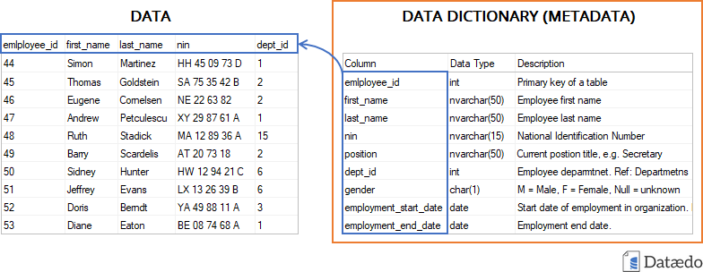
Data Dictionary
Example

Slide 6
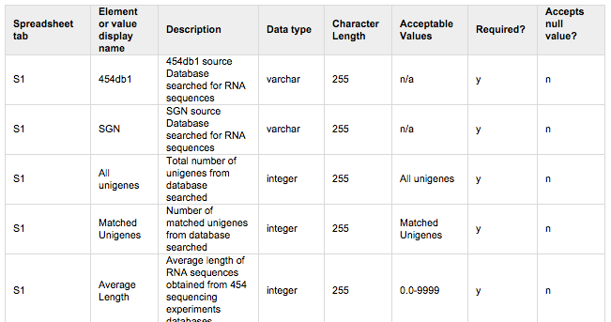
Data Dictionary
Example

Slide 7
Data Dictionary
Many database management systems now come equipped with an automated data dictionary.
The data dictionary may be used to:
Providing documentation and eliminating redundancy
Validate the data flow diagram for completeness and accuracy.
Provide a starting point for developing screens and reports.
Determine the contents of data stored in files.
Develop the logic for data flow diagram processes.
Create XML (extensible markup language).

Slide 8
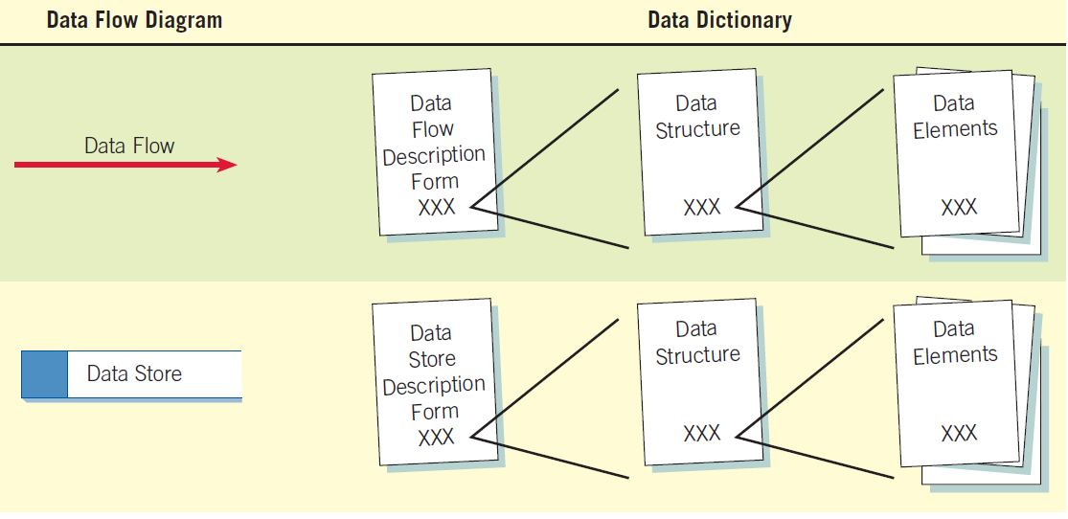
Data Dictionary
The data dictionary is created by examining and describing the contents of the data flows, data stores, and processes.
Categories:
Data flows
Data structures
Data elements
Data stores

Slide 9
Data Dictionary
The data dictionary for this example contains:
Customer data (name, address, phone, …)
Order details (description, size, color, price, …)
Payment method
*Refer to the book page 210 for DFD

Slide 10
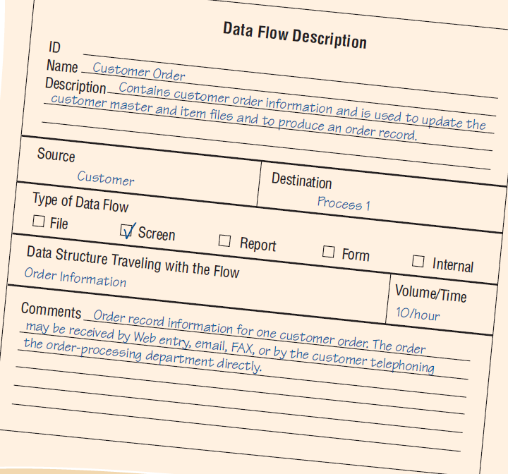
Data Dictionary-data flow
Data flows are usually the first components to be defined.
Data flow description representing the screen used to add a new CUSTOMER ORDER and to update the customer and item files.

Slide 11
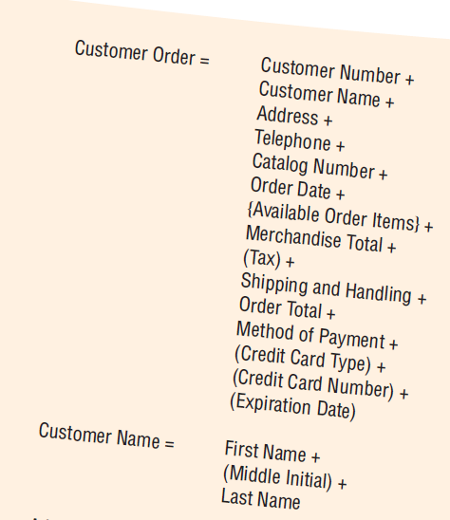
Data Dictionary-data structure
This method allows the analyst to produce a view of the elements that make up the data structure along with information about those elements.
*Refer to the book page 232 for data structure example

Slide 12
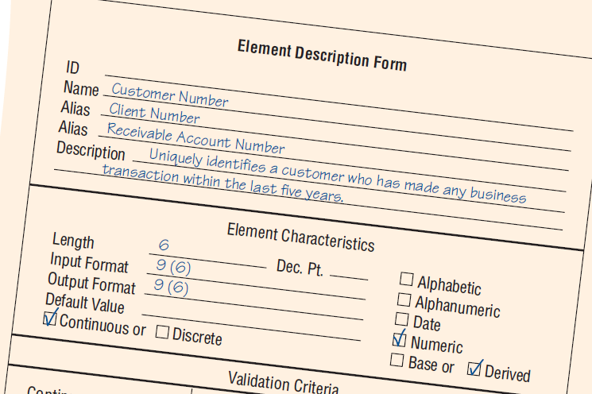
Data Dictionary-data elements
Each data element should be defined once in the data dictionary.
*Refer to the book page 234

Slide 13
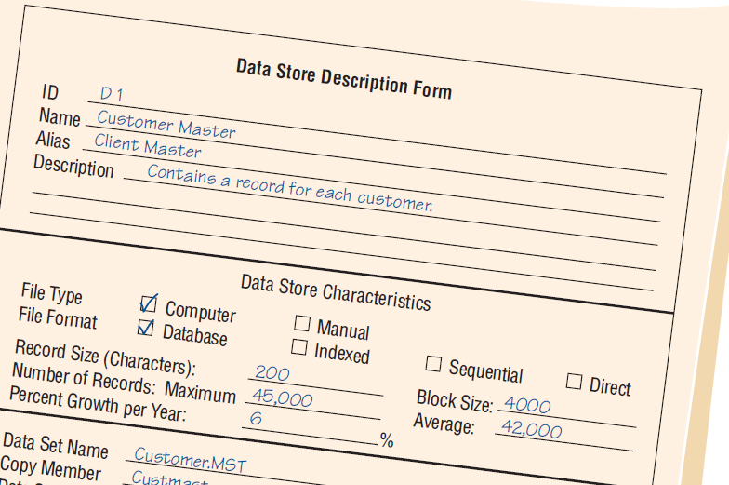
Data Dictionary-data stores
Describes the database that stores data.
*Refer to the book page 237

Slide 14
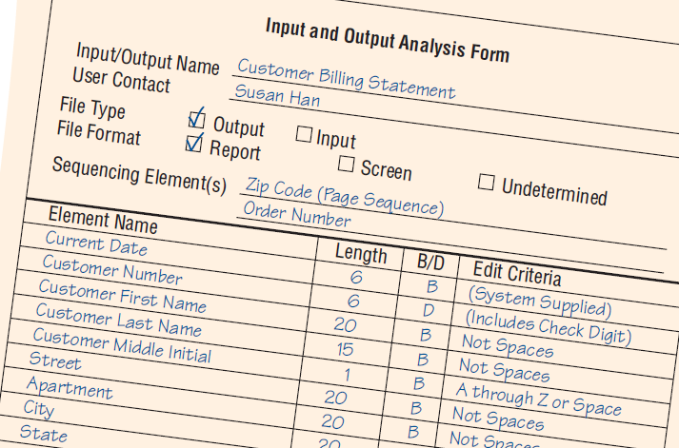
Data Dictionary
An important step in creating the data dictionary is to identify and categorize system input and output data flow.
*Refer to the book page 240

Slide 15
Summary
The systems analyst uses data flow diagrams to begin compiling a data dictionary.
Data dictionary is a reference work containing data about data, or metadata, on
Data processes
Data stores
Data flows
Data structures

Slide 16
TASKS
DAY 03 TASK

